Slide 1


UNIT 7:
On top of the world
At the pet shop

Slide 2
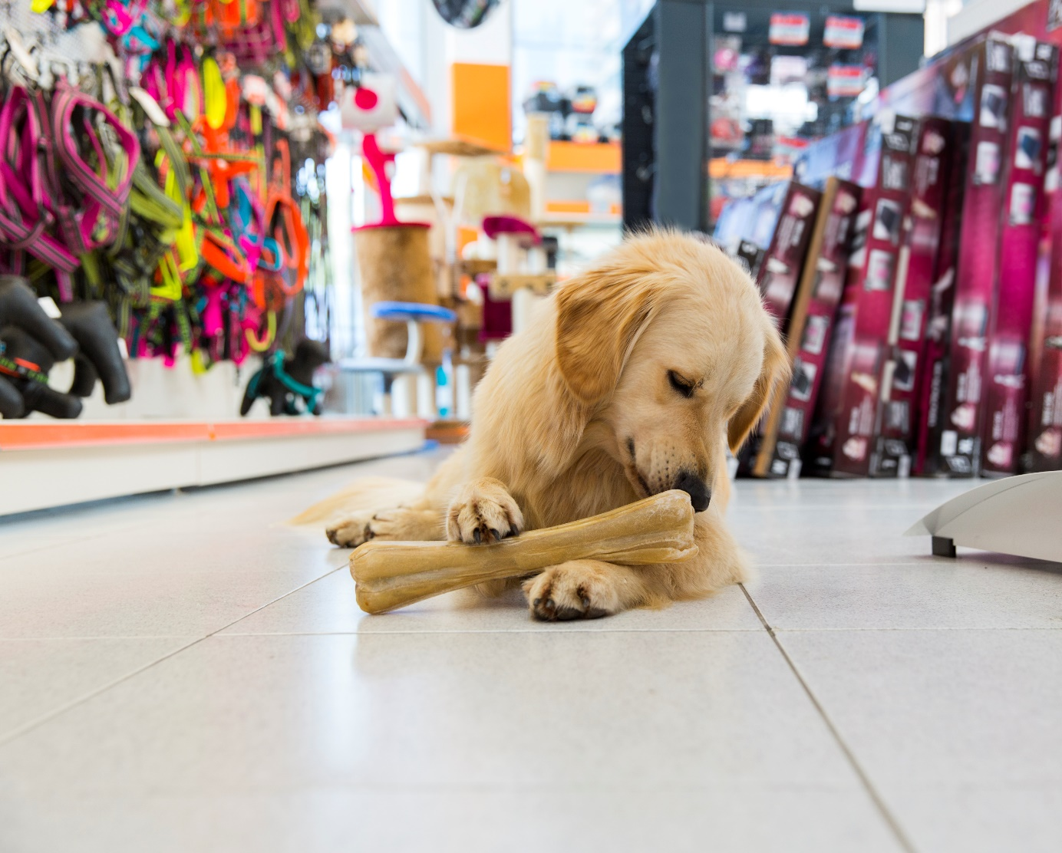
How many of you go to the pet shop regularly?
What do you buy?
What does a dog need?
What does a cat need?
What about a fish or a turtle or a rabbit?

Slide 3
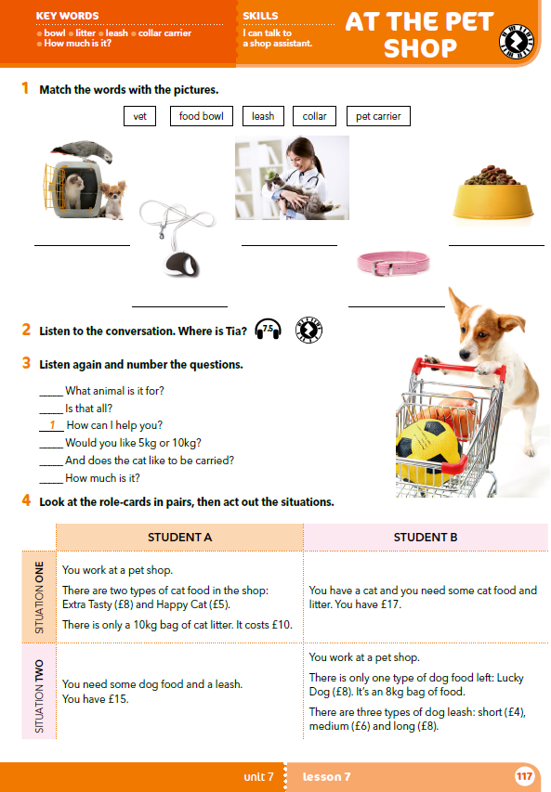
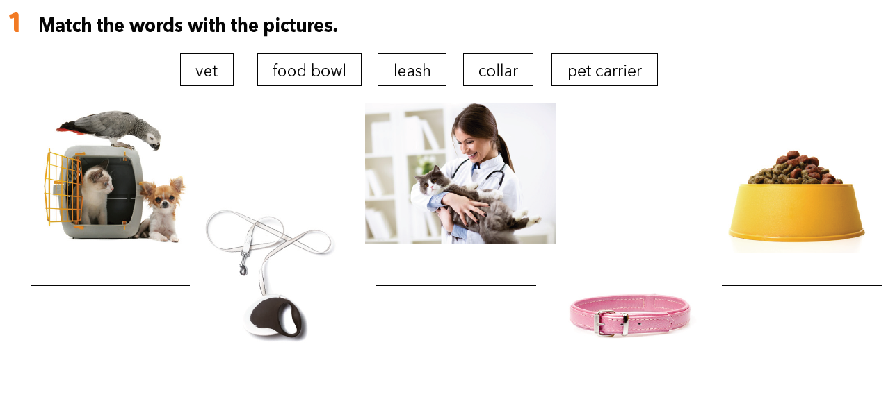
a pet carrier
vet
food bowl
leash
collar

Slide 4

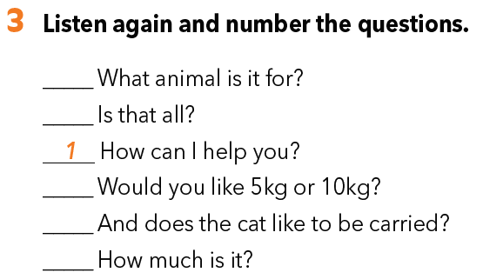
Where do you think Tia is?
What is she doing?
Listen to the conversation and find out.
https://www.e-sfera.hr/dodatni-digitalni-sadrzaji/e4485cb5-8386-4cfa-8606-1f9ce0aaf803/assets/audio/57_pet_shop.mp3
2
6
5
3
4

Slide 5
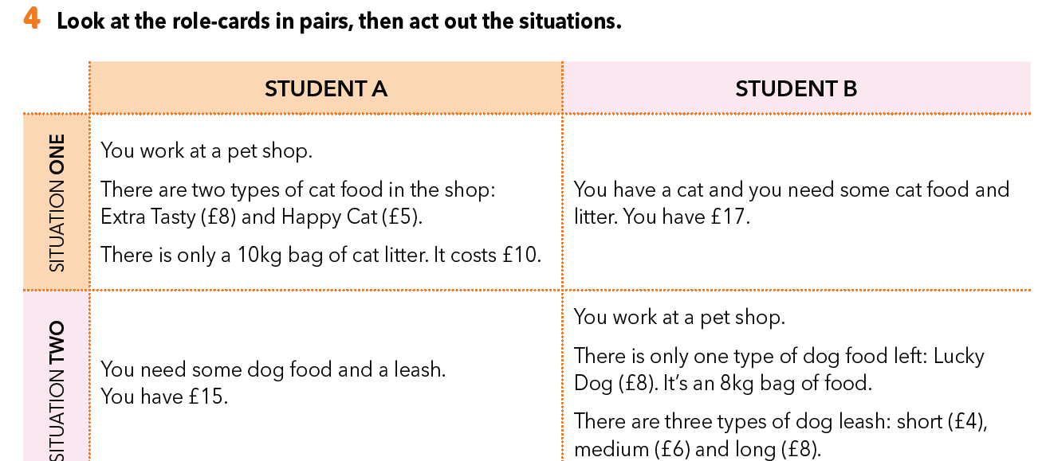

Slide 6
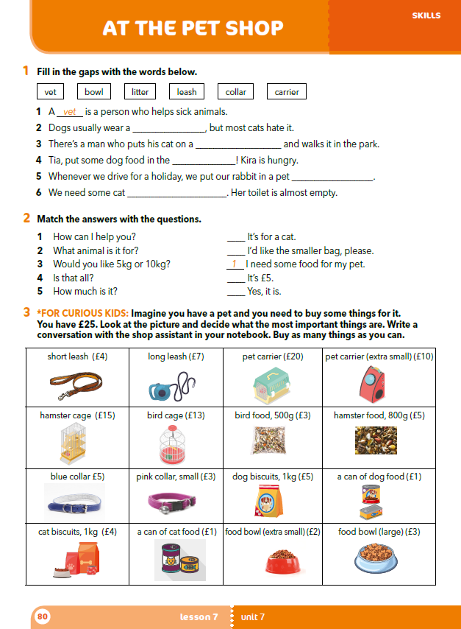
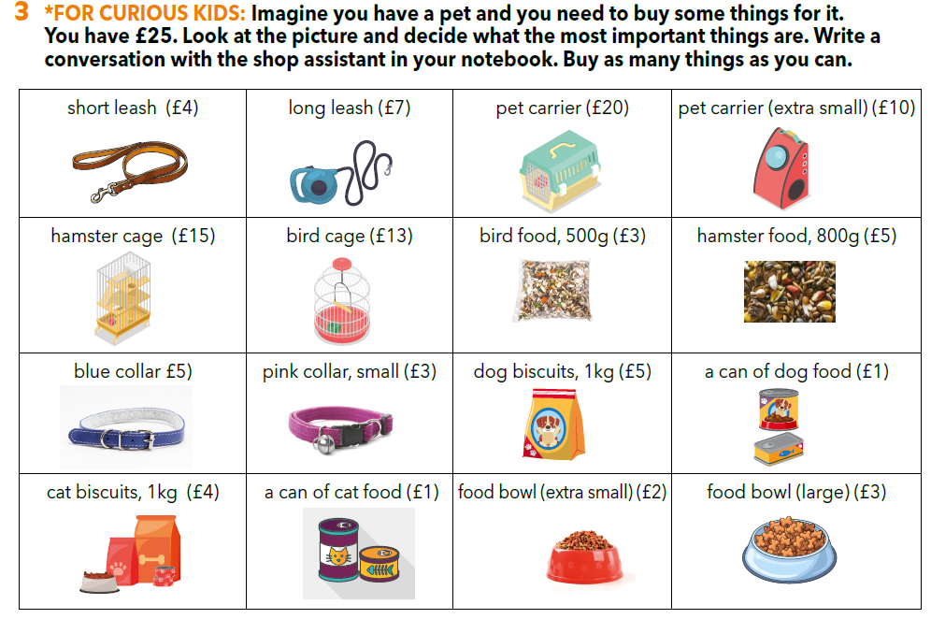
Workbook p 80.

Slide 7
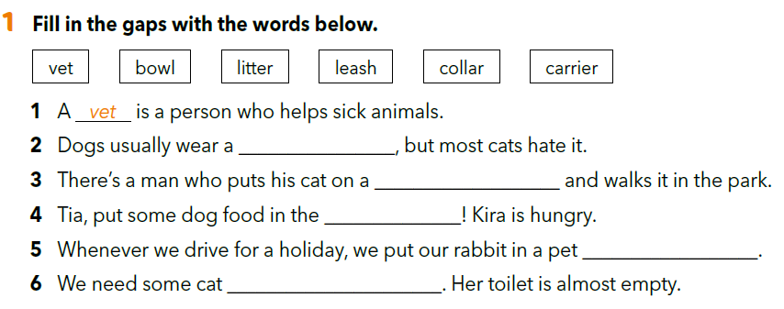
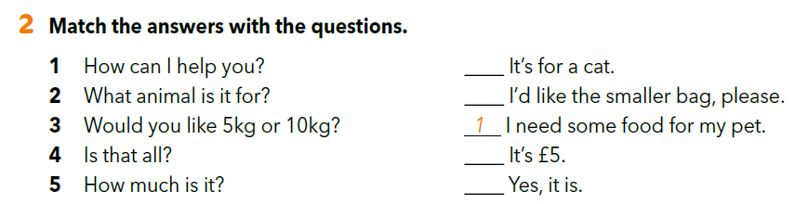
collar
leash
bowl
carrier
litter
2
3
5
4

Slide 8

https://wordwall.net/resource/261677/pet-shop
LET’S REVISE!
LEARN MORE
https://www.e-sfera.hr/dodatni-digitalni-sadrzaji/e4485cb5-8386-4cfa-8606-1f9ce0aaf803/
Animals with jobs

